Slide 1

INT 404 – Artificial Intelligence Artificial Intelligence in Robotics
LOVELY PROFESSIONAL UNIVERSITY
School of Computer Science & Engineering

Slide 2
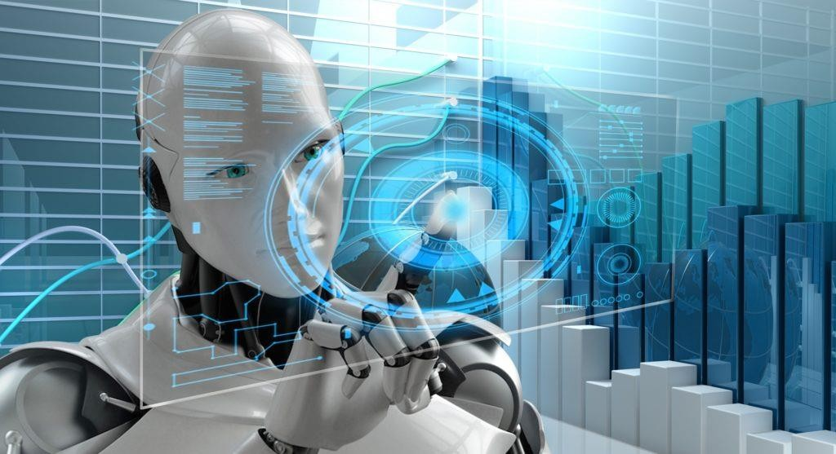
Introduction
Robotics is a separate entity in Artificial Intelligence that helps study the creation of intelligent robots or machines. Robotics combines electrical engineering, mechanical engineering and computer science & engineering as they have mechanical construction, electrical component and programmed with programming language.

Slide 3
Although, Robotics and Artificial Intelligence both have different objectives and applications, but most people treat robotics as a subset of Artificial Intelligence (AI). Robot machines look very similar to humans, and also, they can perform like humans, if enabled with AI.
In earlier days, robotic applications were very limited, but now they have become smarter and more efficient by combining with Artificial Intelligence. AI has played a crucial role in the industrial sector by replacing humans in terms of productivity and quality. In this article, 'Robotics and Artificial Intelligence, we will discuss Robots & Artificial Intelligence and their various applications. Let's start with the definition of Artificial Intelligence (AI) and Robots.
What is Artificial Intelligence?
Artificial Intelligence is defined as the branch of Computer Science & Engineering, which deals with creating intelligent machines that perform like humans. Artificial Intelligence helps to enable machines to sense, comprehend, act and learn human like activities.

Slide 4
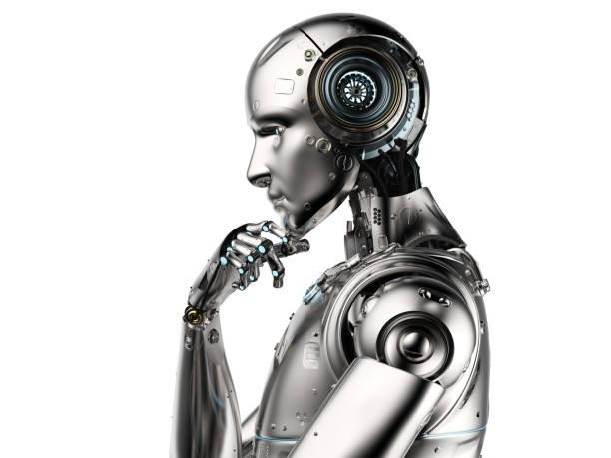
What is a robot?
A robot is a machine that looks like a human, and is capable of performing out of box actions and replicating certain human movements automatically by means of commands given to it using programming. Examples: Drug Compounding Robot, Automotive Industry Robots, Order Picking Robots, Industrial Floor Scrubber, etc.

Slide 5
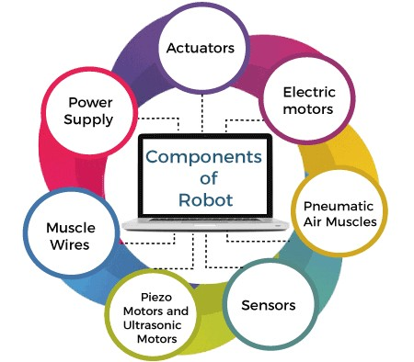
Components of Robot

Slide 6
Actuators: Actuators are the devices that are responsible for moving and controlling a system or machine. It helps to achieve physical movements by converting energy like electrical, hydraulic and air, etc. Actuators can create linear as well as rotary motion.
Power Supply: It is an electrical device that supplies electrical power to an electrical load. The primary function of the power supply is to convert electrical current to power the load.
Electric Motors: These are the devices that convert electrical energy into mechanical energy and are required for the rotational motion of the machines.
Pneumatic Air Muscles: Air Muscles are soft pneumatic devices that are ideally best fitted for robotics. They can contract and extend and operate by pressurized air filling a pneumatic bladder. Whenever air is introduced, it can contract up to 40%.
Muscles wire: These are made up of nickel-titanium alloy called Nitinol and are very thin in shape. It can also extend and contract when a specific amount of heat and electric current is supplied into it. Also, it can be formed and bent into different shapes when it is in its martensitic form. They can contract by 5% when electrical current passes through them.

Slide 7
Piezo Motors and Ultrasonic Motors: Piezoelectric motors or Piezo motors are the electrical devices that receive an electric signal and apply a directional force to an opposing ceramic plate. It helps a robot to move in the desired direction. These are the best suited electrical motors for industrial robots.
Sensor: They provide the ability like see, hear, touch and movement like humans. Sensors are the devices or machines which help to detect the events or changes in the environment and send data to the computer processor. These devices are usually equipped with other electronic devices. Similar to human organs, the electrical sensor also plays a crucial role in Artificial Intelligence & robotics. AI algorithms control robots by sensing the environment, and it provides real-time information to computer processors.

Slide 8
Application of Robotics
Robotics have different application areas. Some of the important applications domains of robotics are as follows:
Robotics in defence sectors: The defence sector is undoubtedly the one of the main parts of any country. Each country wants their defence system to be strong. Robots help to approach inaccessible and dangerous zone during war. DRDO has developed a robot named Daksh to destroy life-threatening objects safely. They help soldiers to remain safe and deployed by the military in combat scenarios. Besides combat support, robots are also deployed in anti-submarine operations, fire support, battle damage management and strike missions.
Robotics in Medical sectors: Robots also help in various medical fields such as neurosurgery, orthopaedic surgery, disinfecting rooms, dispensing medication, and various other medical domains.

Slide 9
Robotics in Industrial Sector: Robots are used in various industrial manufacturing industries such as cutting, welding, assembly, disassembly, pick and place for printed circuit boards, packaging & labelling, palletizing, product inspection & testing, colour coating, drilling, polishing and handling the materials.
Moreover, Robotics technology increases productivity and profitability and reduces human efforts, resulting from lower physical strain and injury. The industrial robot has some important advantages, which are as follows:
Accuracy
Flexibility
Reduced labour charge
Low noise operation
Fewer production damages
Increased productivity rate.
Robotics in Entertainment: Over the last decade, use of robots is continuously getting increased in entertainment areas. Robots are being employed in entertainment sector, such as movies, animation, games and cartoons.

Slide 10
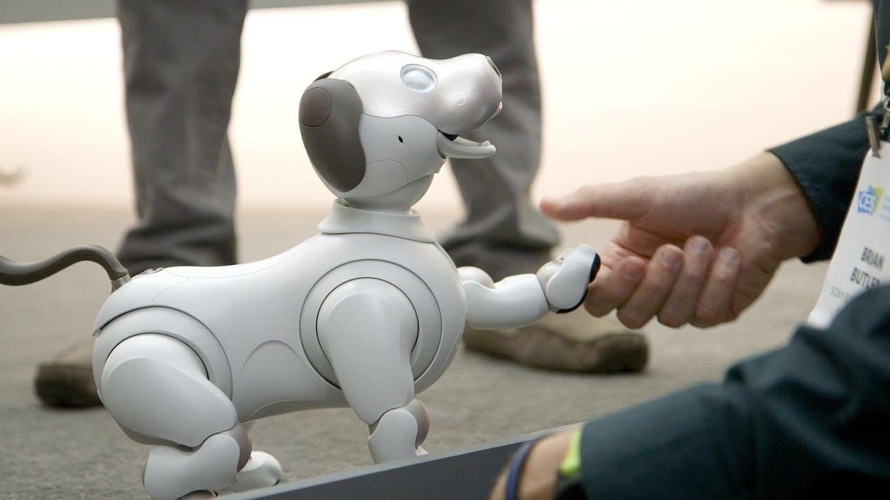
Robots are very helpful where repetitive actions are required. A camera-wielding robot helps shoot a movie scene as many times as needed without getting tired and frustrated. A big-name Disney has launched hundreds of robots for the film industry.
Robots in the mining industry: Robotics is very helpful for various mining applications such as robotic mapping & surveying, robotic drilling and explosive handling, etc. A mining robot can solely navigate flooded passages and use cameras and other sensors to detect valuable minerals. Further, robots also help in excavation to detect gases and other materials and keep humans safe from harm and injuries. The robot rock climbers are used for space exploration, and underwater drones are used for ocean exploration.

Slide 11
Methodology
There are only a few methods that describe the combination of artificial intelligence and development methodologies. This section introduces relevant works related to this topic. A deep learning lifecycle management administers the modeling of lifecycles and deep neural networks. It describes the implementation and application of a deep learning system. The main focus of this work is on the structuring and organization of artificial neural networks. Another development methodology introduces a concept
that characterizes the use of artificial intelligence for model-based development. In a further approach, AI is used in combination with simulation tools to develop prototypes for robotic applications. There are also combinations with traditional development
methodologies. The model is used for the development of complex and ﬂexible
applications.

Slide 12
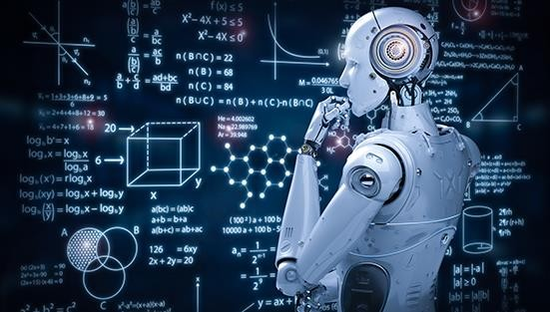
However, there are methods that already contain many features, mention methodologies in combination with artificial intelligence. On one hand, on the basis of the traditional methods the required criteria have been analyzed to be able to use new functional aspects such as AI, machine learning or self-optimizing systems through reinforcement learning. On the other hand, technological factors are used for applicability and transferability through simulation and real applications. The process parameters characterize supporting features for the integration in a real process environment.

Slide 13
Future works
Undoubtedly, Artificial Intelligence (AI) is a revolutionary field of computer science, which is ready to become the main component of various emerging technologies like big data, robotics, and IoT. It will continue to act as a technological innovator in the coming years. In just a few years, AI has become a reality from fantasy. Machines that help humans with intelligence are not just in sci-fi movies but also in the real world. At this time, we live in a world of Artificial Intelligence that was just a story though for some years
We are using AI technology in our daily lives either unknowingly or knowingly, and somewhere it has become a part of our life. Ranging from Alexa/Siri to Chatbots, everyone is carrying AI in their daily routine. The development and evolution of this technology are happening at a rapid pace. However, it was not as smooth and easy as it seemed to us. It has taken several years and lots of hard work & contributions of various people to take AI at this stage. Being so revolutionary technology, AI also deals with many controversies about its future and impact on Human beings. It may be dangerous, but also a great opportunity.
AI will be deployed to enhance both defensive and offensive cyber operations. Additionally, new means of cyber-attack will be invented to take advantage of particular vulnerabilities of AI technology.

Slide 14
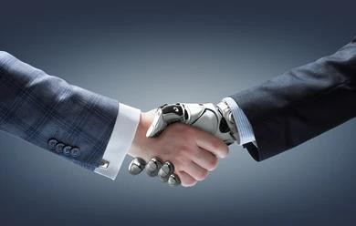
Conclusion
Today we find most robots working for people in industries, factories, warehouses, and laboratories. Robots are useful in many ways. For instance, it boosts economy because businesses need to be efficient to keep up with the industry competition. Therefore, having robots helps business owners to be competitive, because robots can do jobs better and faster than humans can, e.g. robot can built, assemble a car. Yet robots cannot perform every job; today robots roles include assisting research and industry. Finally, as the technology improves, there will be new ways to use robots which will bring new hopes and new potentials.

Slide 15
References
https://www.researchgate.net/publication/344784883_Robotics_and_Artificial_Intelligence
https://arxiv.org/ftp/arxiv/papers/1803/1803.10813.pdf
https://www.geeksforgeeks.org/artificial-intelligence-in-robotics/ https://aibusiness.com/verticals/robotics-and-artificial-intelligence-the-role-of-ai-in-robots

